Slide 1
Accelerating Corrosion Detection with Adaptive Sampling A Comparative Analysis with Random Sampling
Ghezal Ahmad Zia
Christoph Volker

Slide 2
Introduction
Objective: Efficiently locate corroded areas within a grid using minimal sampling.
Challenge: Traditional random sampling can be resource-intensive and time-consuming.

Slide 3
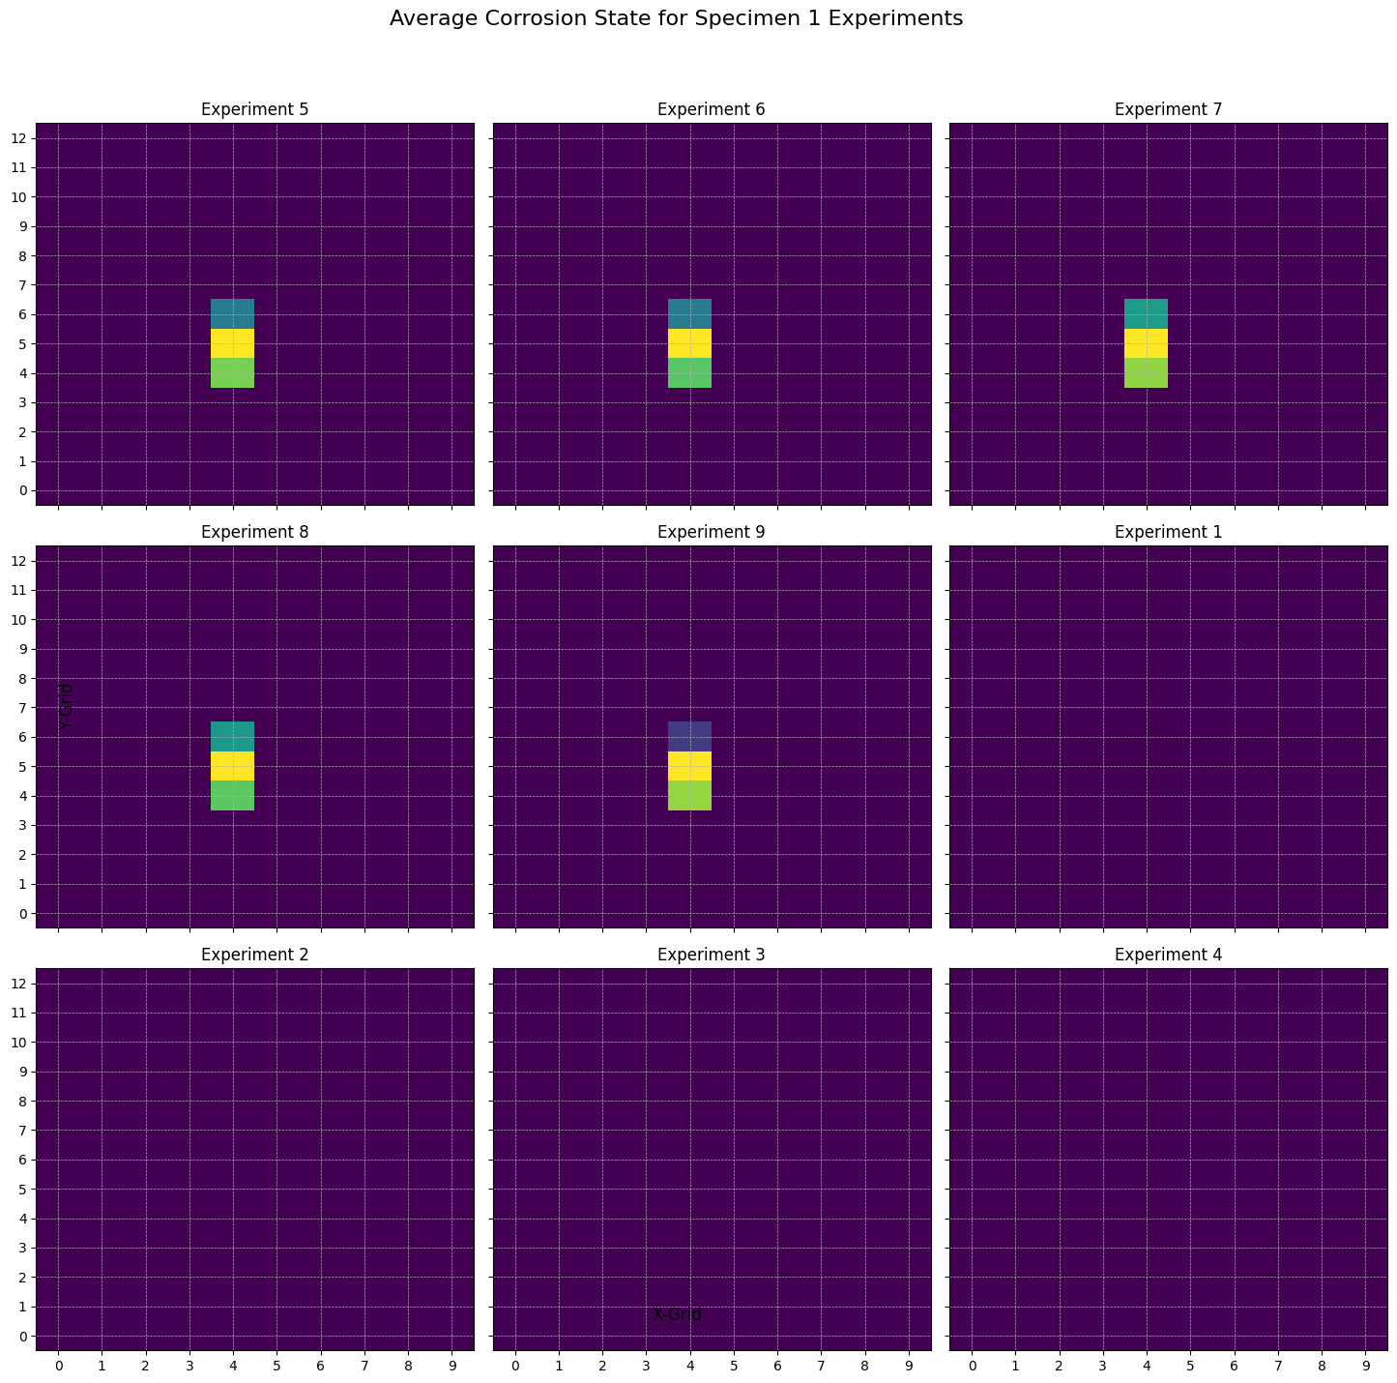
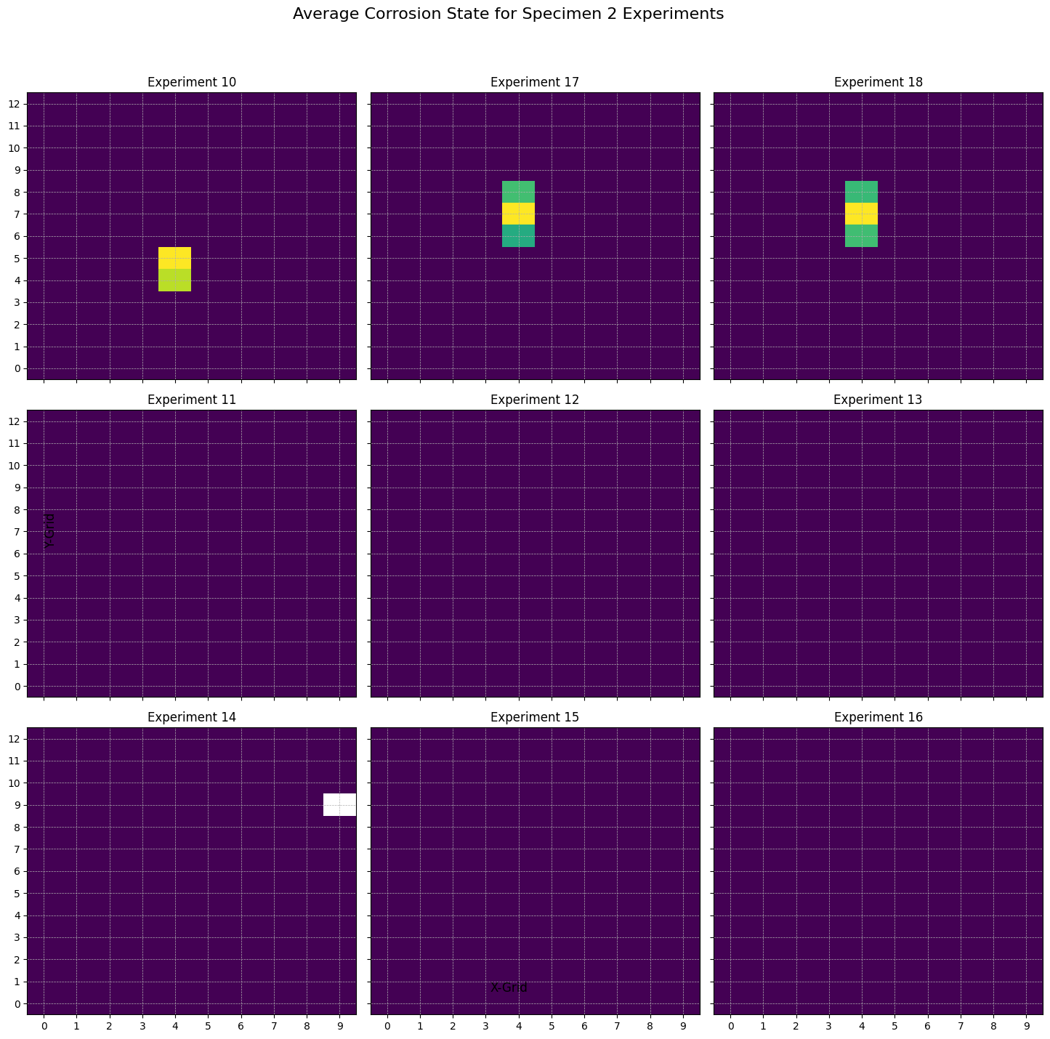
Data Overview

Slide 4
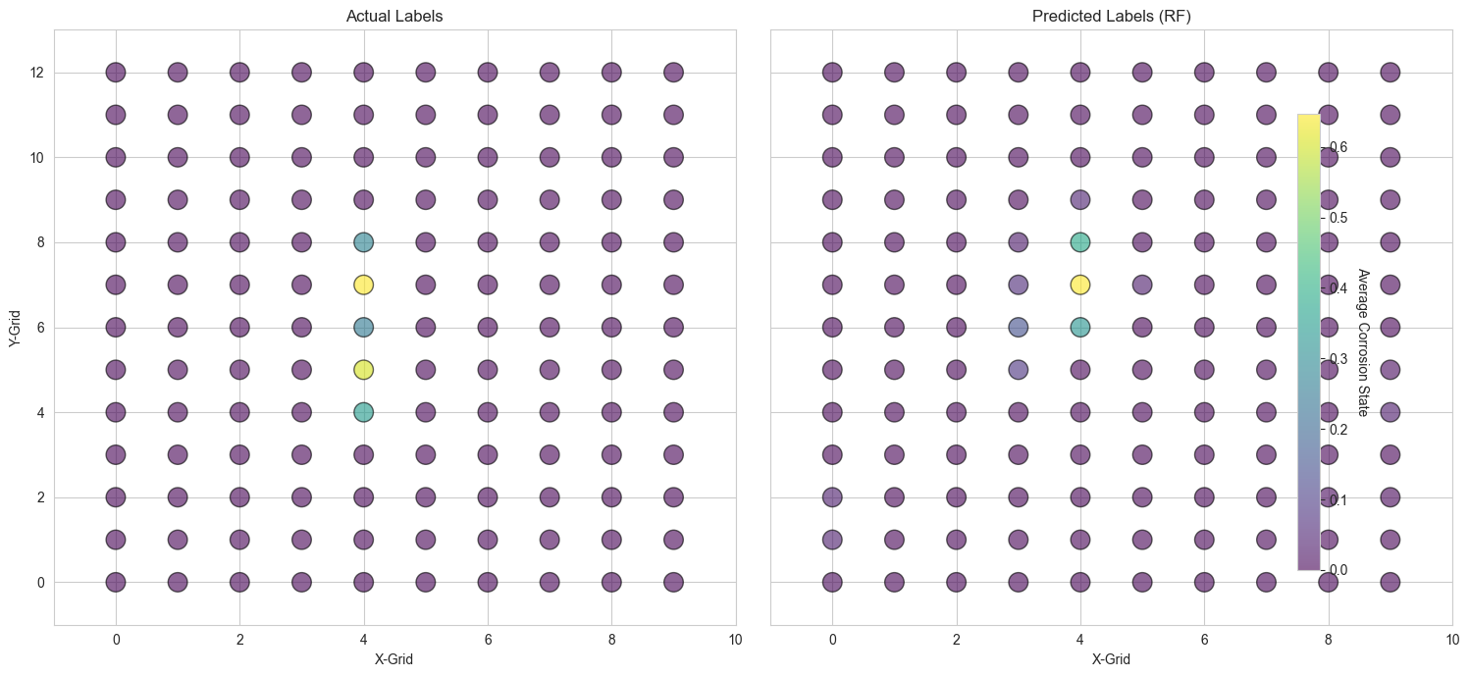

Slide 5
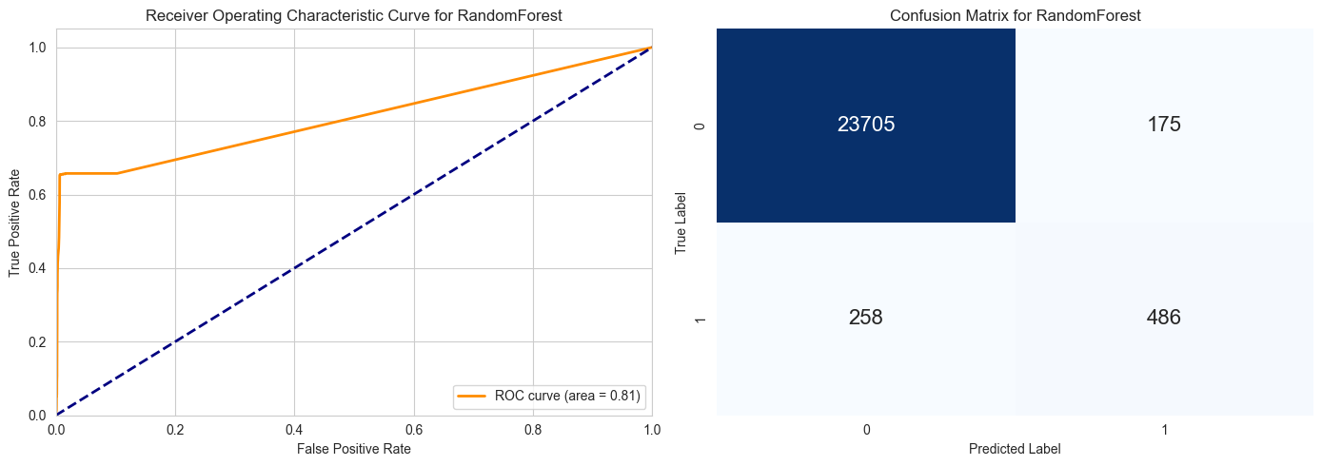
Classification Report:
Precision: The model has a precision of 0.99 for class 0 (indicating non-corrosion) and 0.74 for class 1 (indicating corrosion).
Recall: The recall is 0.99 for class 0 and 0.65 for class 1.
F1-Score: The F1-score, which is the harmonic mean of precision and recall, is 0.99 for class 0 and 0.69 for class 1.
Accuracy: The overall accuracy of the model is 98.24%.

Slide 6
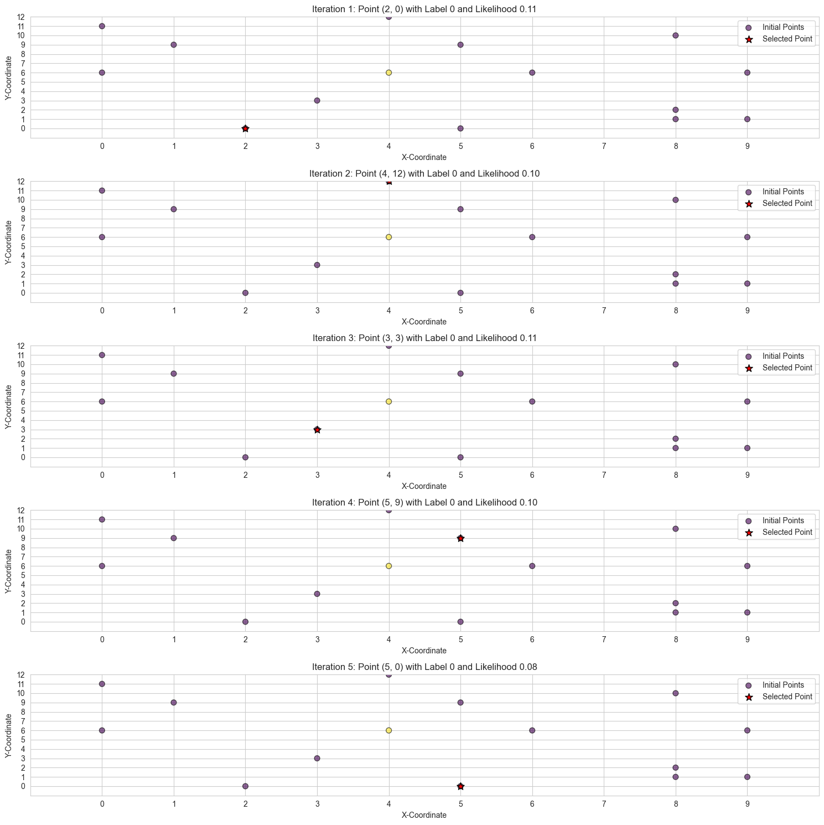

Slide 7
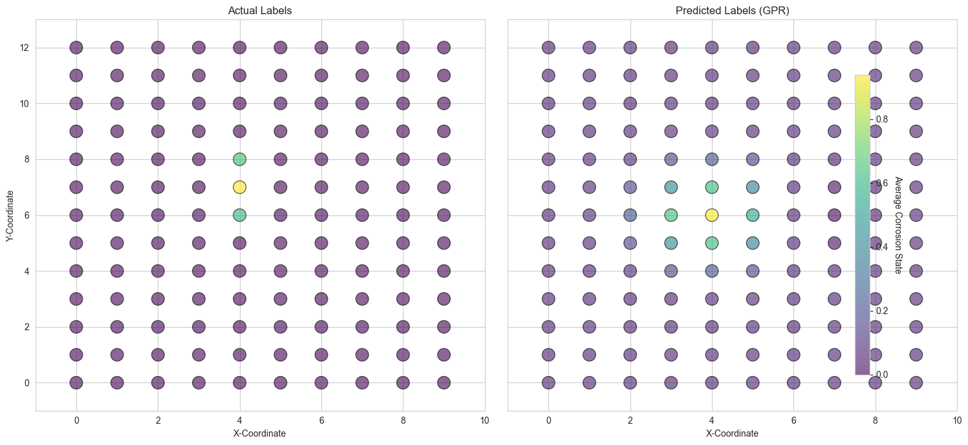

Slide 8
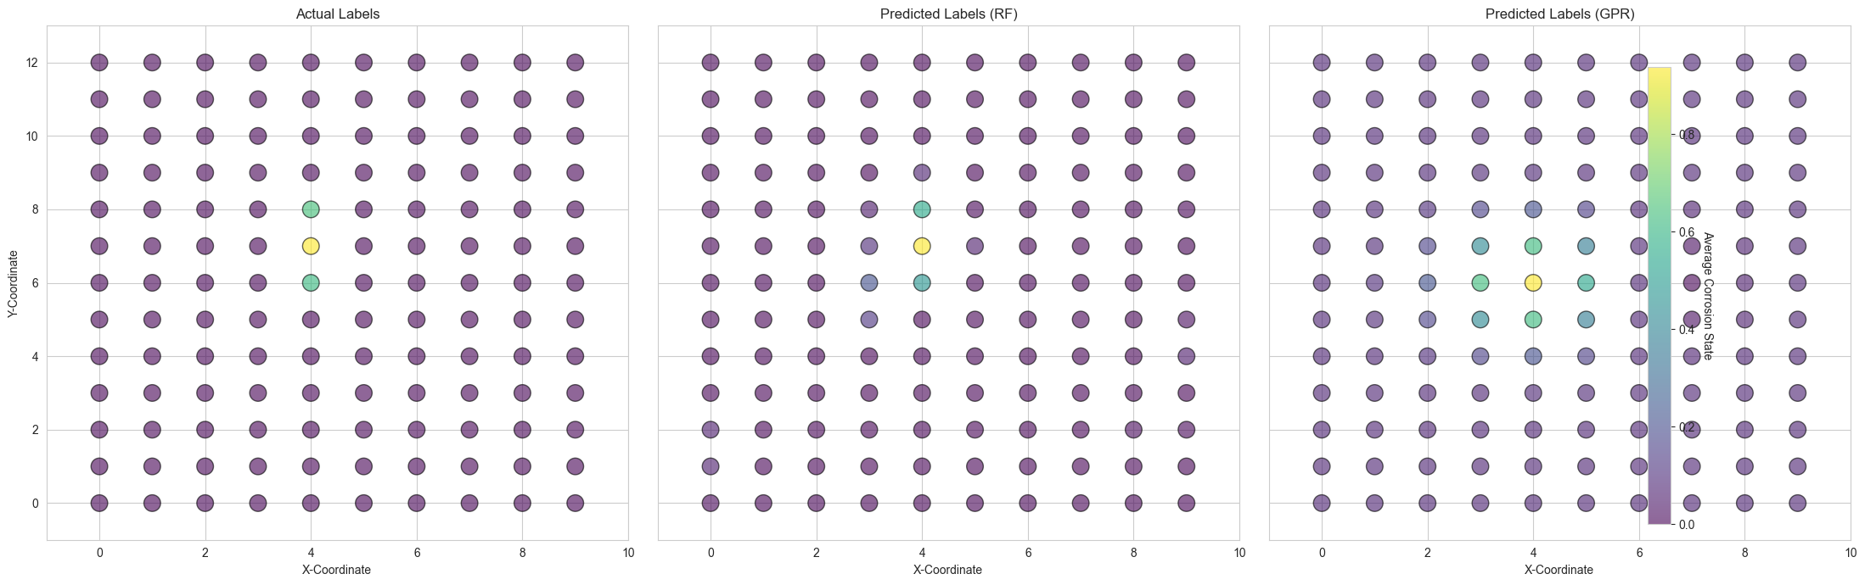

Slide 11
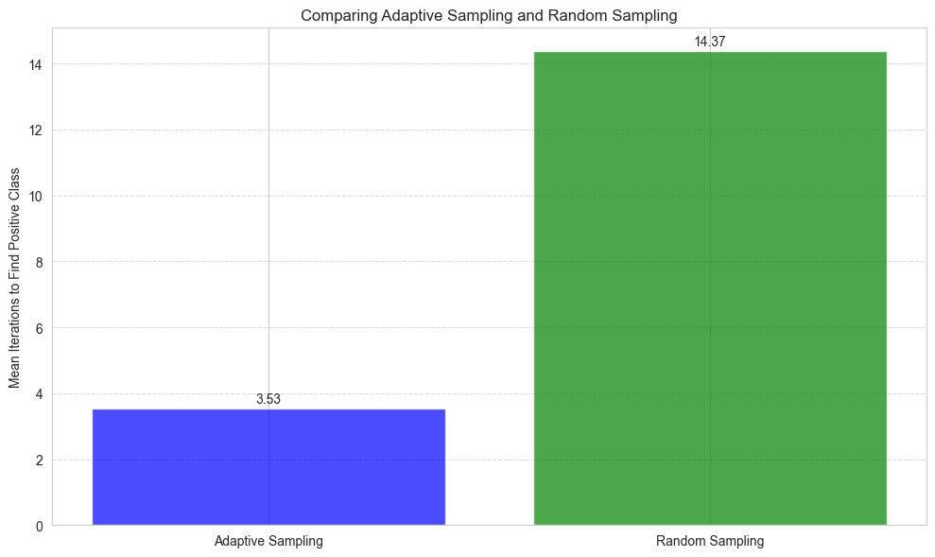
average number of samples needed to identify a positive class

Slide 12
Material Usage per Sample - hypothetical value
Material Usage per Sample: $100
Samples in Traditional Approach: 15
Samples in Adaptive Sampling: 4 (on average)
We can now calculate the material savings using the formula:
Material Savings=Material Usage per Sample×(Samples in Traditional Approach−Samples in Adaptive Sampling)
Material Savings=$100×(15−4)
Material Savings=$100×11
Material Savings=$1100

Slide 13

Real-World Implication
$$Acceleration Factor= \frac{\text{Avg}\text{. }\text{Samples}\text{ (}\text{Adaptive} \text{Sampling}\text{)}}{\text{Avg}\text{. }\text{Samples}\text{ (}\text{Random} \text{Sampling}\text{)}}$$
$Acceleration Factor= \frac{15}{4}$ =3.75
adaptive sampling can potentially find a positive class 4 times faster than traditional random sampling.

